Slide 1
Customer Retention Project

Slide 2
Problem Statement And Understanding
Customer satisfaction has emerged as one of the most important factors that guarantee the success of online store; it has been positioned as a key stimulant of purchase, repurchase intentions and customer loyalty. A comprehensive review of the literature, theories and models have been carried out to propose the models for customer activation and customer retention.
Five major factors that contributed to the success of an e-commerce store have been identified as: service quality, system quality, information quality, trust and net benefit.
The research furthermore investigated the factors that influence the online customers repeat purchase intention.
The combination of both utilitarian value and hedonistic values are needed to affect the repeat purchase intention (loyalty) positively.
The data is collected from the Indian online shoppers. Results indicate the e-retail success factors, which are very much critical for customer satisfaction.

Slide 3
Exploratory Data Analysis
Variable Data-types:
Only the ‘4 What is the Pin Code of where you shop online from?’ is integer type.
All the other columns are objects
Null Values: There are no Null values.
Shape: There are 269 records and 71 features.

Slide 4
Visualizations

Slide 5
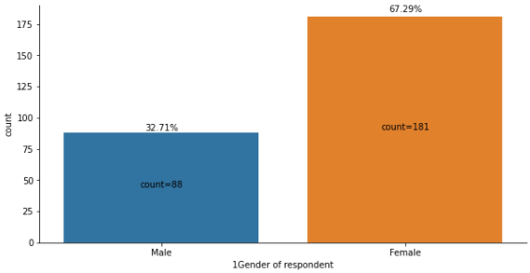
Distribution of the genders in the customers population
The dataset contains more female respondents than male.

Slide 6
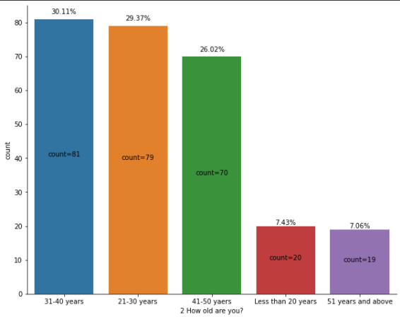
Distribution of Age ranges of the customers
Most of the respondents are in the age groups of 30s, 20s and 40s as 1st, 2nd and 3rd places.
The age groups less than 20 and 51 and above are very less.

Slide 7
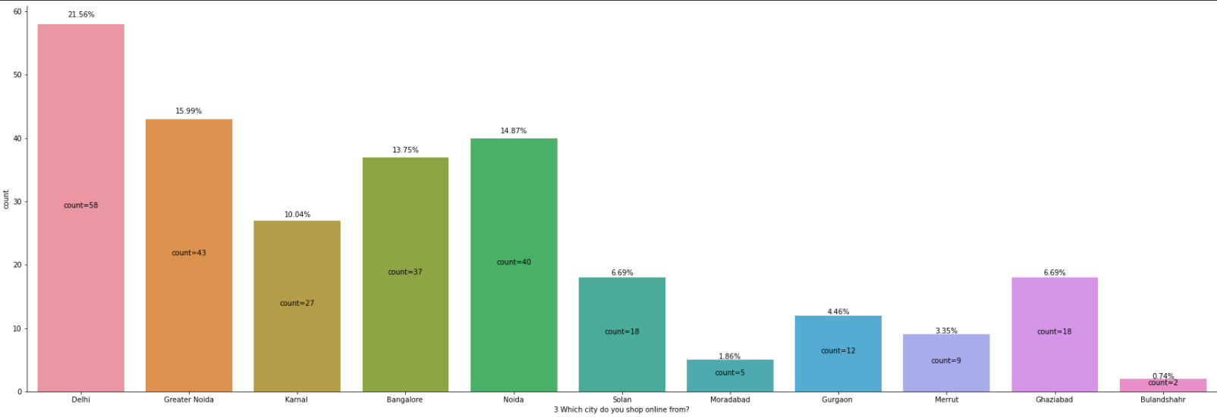
Distribution of customers from each cities
Among the available cities, Delhi has the highest number of respondents followed by Greater Noida, Noida, Banglorein the subsequent places.
Bulandshahr has the lowest number of respondents.

Slide 8
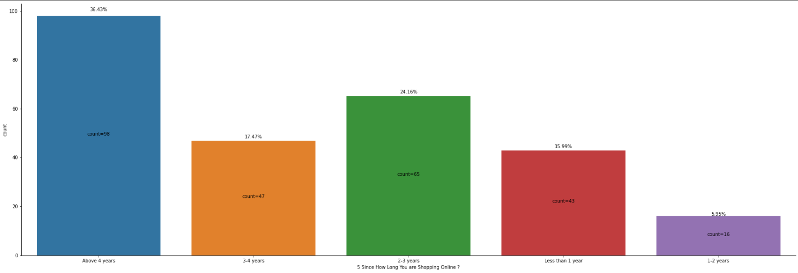
Customers’ online shopping age
The data shows that Most of the customers are using online shopping for more than 4 years. This indicates that there is a large number of repeat customers.
There is also an increased number of customers using online shopping within 1 year than customers using online shopping for 1-2 years. This indicates that online shopping is getting popular again recently although there was a slight decrease in the 1-2 years' population.

Slide 9
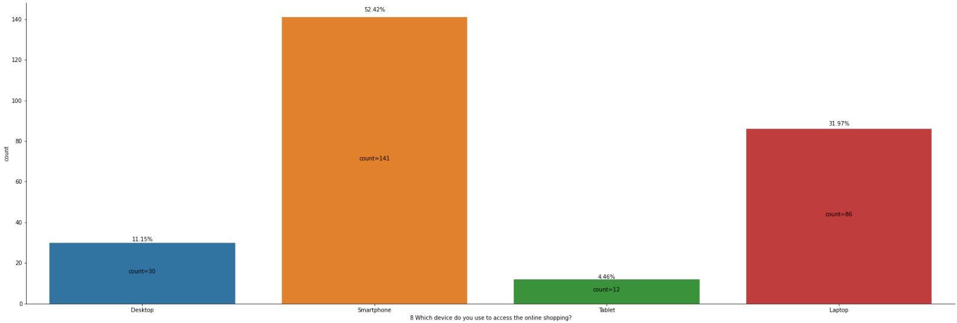
Devices used to access the online stores
Smartphone is the most used device to visit online shopping stores. About 52% of the customers use smartphone to visit the store.

Slide 10
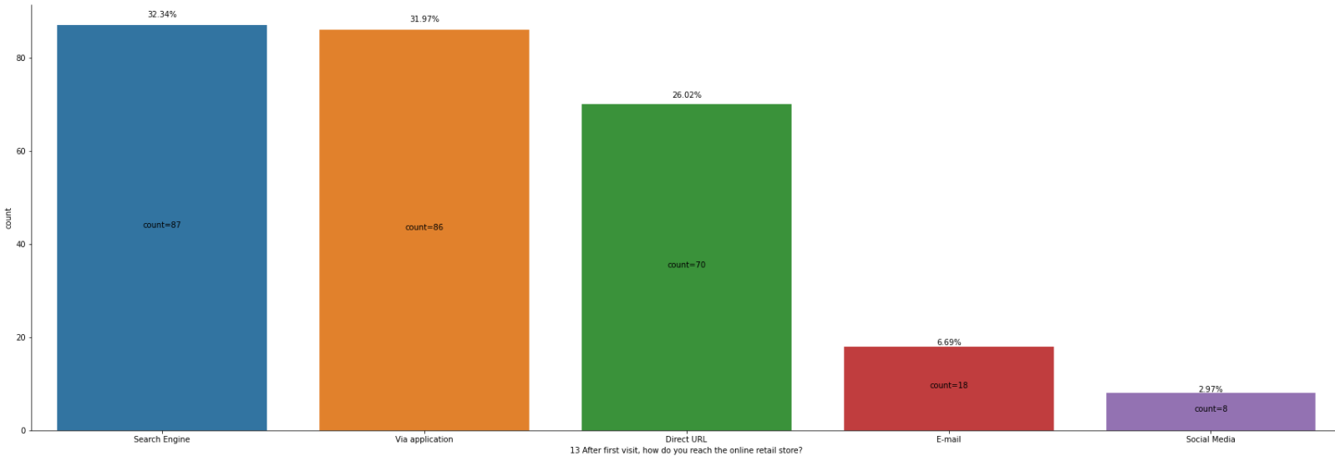
Distribution of campaign platforms
The repeat customers are using Search engines and applications to come back to the online stores after.
Social media channel is the least used channel.

Slide 11
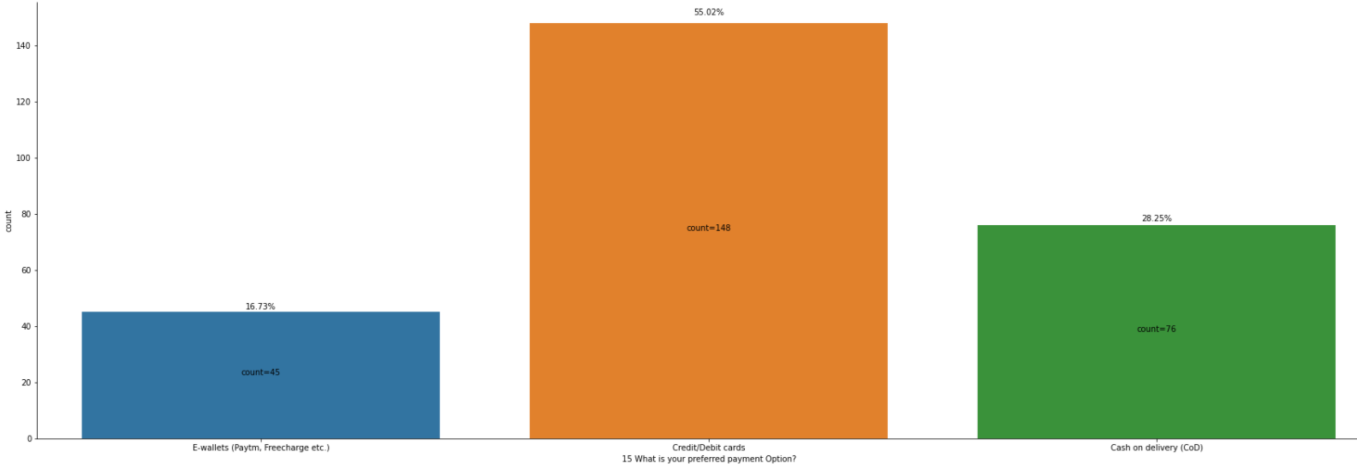
Preferred modes of payment
For about 55% of the customers the preferred payment option is Credit/Debit cards.
E-wallets are still the least preferred option.

Slide 12
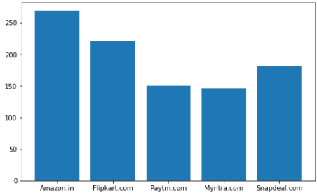
Online Shopping sites used by the customers
Most of the customers are using Amazon websites followed by Flipkart and Snapdeal.
Myntra is the least used site.

Slide 13
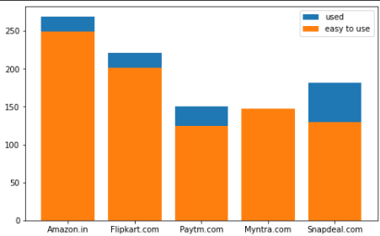
Sites that are easy to use
Most of the customers feel that Amazon is the most easy to use web store followed by Flipkart.
Though many customers are using Snapdeal, not many customers feel that Snapdeal is an easy to use site.

Slide 14
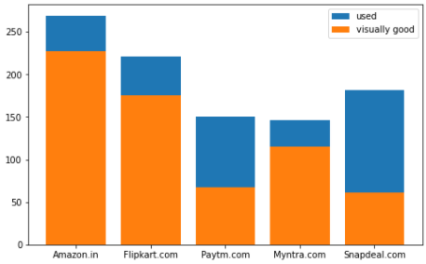
Online sites that are visually good
Amazon is considered as the most visually appealing site.
Snapdeal and Myntra are the least visually appealing sites.
The most percentage of customers of the Myntra site seem to like its visual aspects than any other sites.

Slide 15
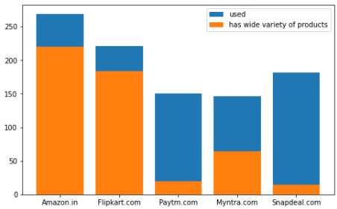
Sites that have wide variety of products
Most of the customers feel that the Amazon site has the wide variety of products on offer followed by Flipkart.
Snapdeal and Paytm sites have the least variety of products.

Slide 16
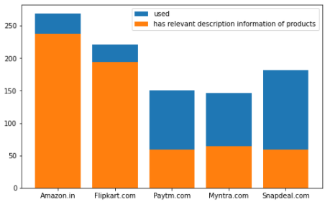
Sites that have relevant description information of Products
Most of the customers think that Amazon and Flipkart sites have the most relevant information on products on the site.
Snapdeal has the least percentage of people thinking that the site has relevant information on products on the site.

Slide 17
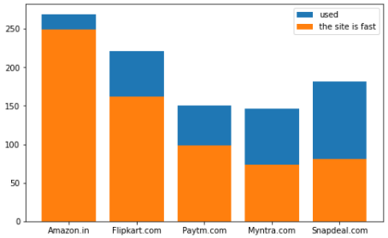
Sites that are fast
Most customers think that the Amazon site is very fast.
Only very less percentage of customers feel that the Snapdeal site is fast.

Slide 18
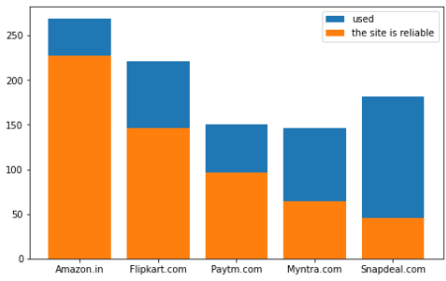
Reliable sites
Amazon is the most reliable site as per the survey.
Snapdeal is the least reliable site as per the survey.

Slide 19
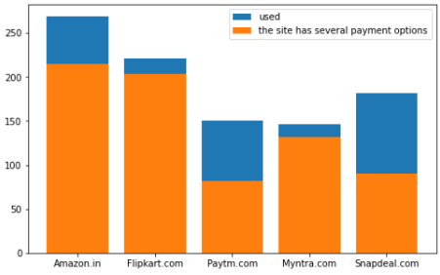
Sites with Several payment options
Most of the customers feel that Amazon has several payment options.
Percentage-wise, most percentage of customers that used Myntra feel that it has several payment options followed by Flipkart.
Most of the customers that used Snapdeal feel that it does not have several payment options.

Slide 20
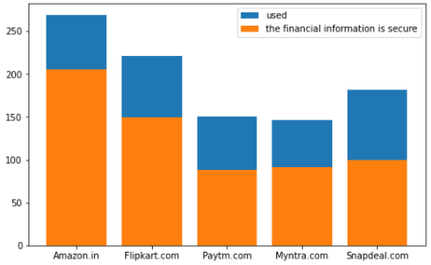
Sites with secure financial informations
Per the survey, the customers feel that the Amazon site has the most security for financial information .
The customers feel that the least secure site is the Paytm site.

Slide 21
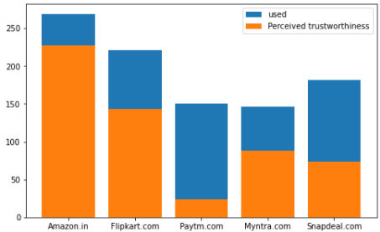
Sites with perceived trustworthiness
The most trustworthy site is Amazon.
The least trustworthy site per the survey is Paytm.

Slide 22
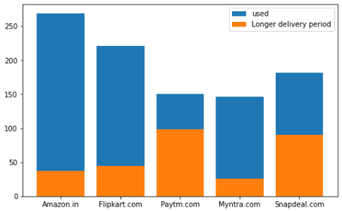
Sites with Longer delivery period
Paytm and Snapdeal have the longest delivery periods.
Most of the Amazon customers feel that the site has a reasonable delivery period.

Slide 23
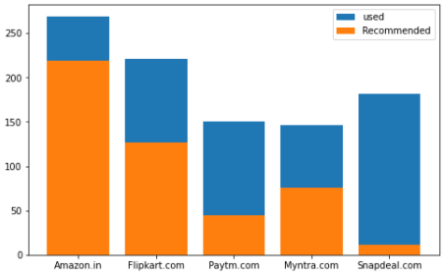
Sites used vs Sites recommended
Amazon is the most recommended store followed by Flipkart.
Snapdeal is the least recommended store though it is used by more customers than Paytm and Myntra.

Slide 24
Steps taken to complete the Project
Extracted the sites separately from the features.

Slide 25
Conclusion
Amazon is the most used and the most recommended online shopping sites.
We could notice that Amazon is topping the list in every features like trustworthiness, speed, ease to use, etc..
For an online site to be successful, it is important for the site to have several payment options, it should be trustworthy, should be fast, should have fast delivery, fast loading page, should contain good information, should have variety of products, etc.

